Slide 1
DIGGING into Attendance
Marti Mauro
mmauro@penfield.edu

Slide 2
Gerry Brooks: Getting kids back to some in-person learning
Notes:
https://www.youtube.com/watch?v=W153kbdwSKM&t=174s

Slide 3
2019-20 SY: March 2020 Shutdown
2020-21 SY: Hybrid / Remote / In School
2021-22 SY: In School – Lots of illness
2022-23 SY: Attendance is REAL

Slide 4
Social Anxiety
Behavior / Violence
Staff Turnover
Family Mobility
Attendance Processes

Slide 5
New York State Education Department
SIRS 360, 361, 371, 375 & 376
Chronic absence
Missing at least ten percent of enrolled school days
Warrants urgent attention
- Diminishes successful student outcomes
- Undermines learning

Slide 6
SIRS 360 provides counts of students enrolled, absent, present, tardy & missing attendance for every day of the instructional calendar.

Slide 7
SIRS 361 provides a YTD summary of attendance days, students enrolled, the # and % of students absent between 0‐4% of days, 5‐9% of days, and 10% > of days.
Using ‘To-Date’ attendance days!
Gr K=16, Gr 1=9,Gr 2=6, Gr 3=3, Gr 4=15, Gr 5=11. Something to look at.

Slide 8
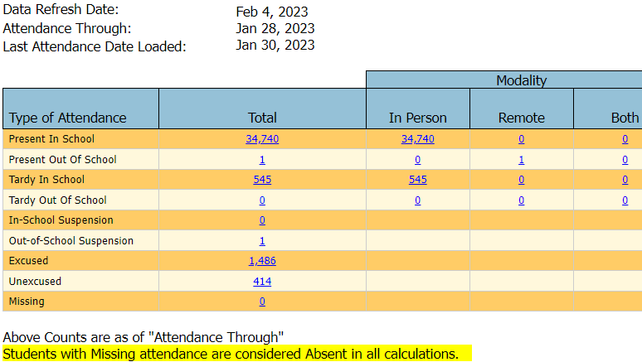
SIRS 371 provides an Attendance Count to date by type of Attendance and Modality.

Slide 9
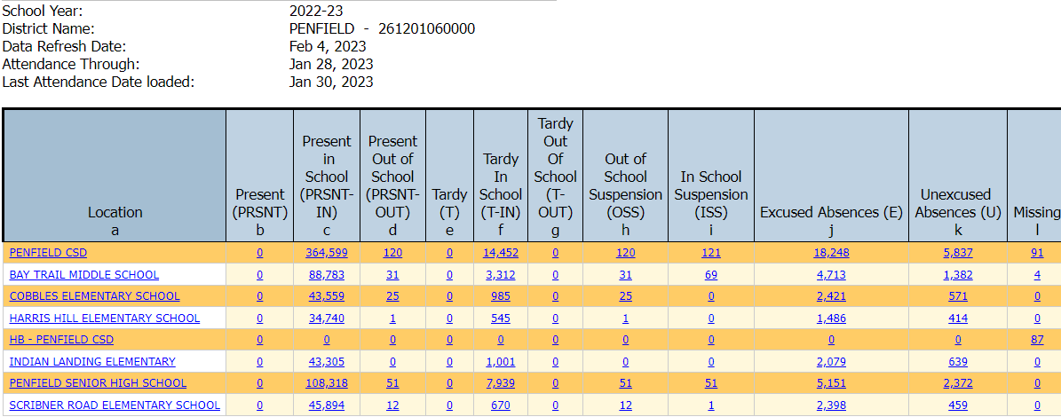
SIRS 375 provides an Attendance Count to date by District-all locations.

Slide 10
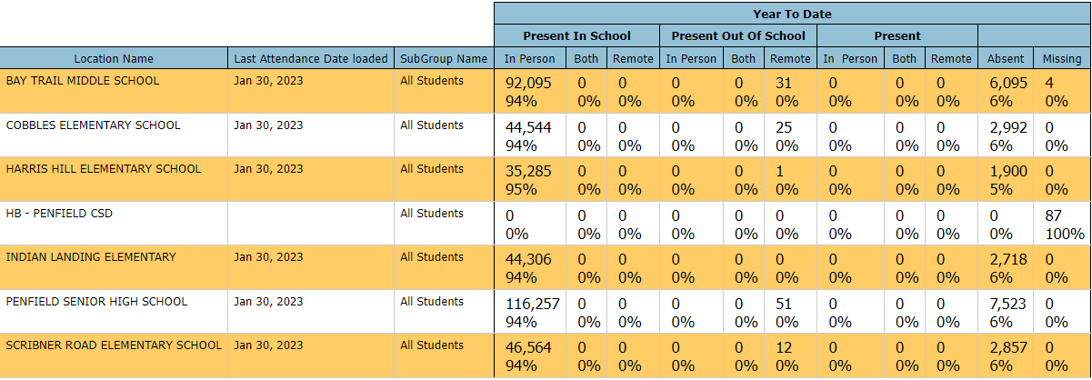
SIRS 376 provides an Attendance Data Flow by region with Subgroups and column (mo) selections

Slide 11
The TEAM
Principals & Assistant Principals overseer this data along with attendance clerks, nurses & counselors
BOE Policy and School Parent/Student Handbook
SIS – Attendance Reports to identify “highflyers”
Bring people together to discuss scenarios & resolutions

Slide 12
Attendance Codes
Our attendance clerks met to discuss the codes used
Data Coordinator reviews scenarios with Principals, Clerks and Counselors
Adjustments are made to better reflect circumstances

Slide 13
InfiniteCampus Codes Displayed (may also be used in Comments)
Code | Meaning | When Is This Used?
A | Absent Unknown | Generated if student is marked Absent by a teacher
ADA | Administrative Absent | Only used if instructed; indicates student was with their Administrator
AE | Absent Excused | Student is absent from class for an excusable reason
AI | Alternative Instruction | Student has a modified schedule and/or attends tutoring
AS | Absent Sick | Student is absent from class due to illness
AU | Absent Unexcused | Student is absent from class without a valid excuse (i.e. Family vacation, sleeping in, no contact from home)

Slide 14
Scenario 1:
A student left the country with her family in November. Mom said she was attending school there and will return in February.

Slide 15
Scenario 1 - What we did:
A student left the country with her family in November. Mom said she was attending school there and will return in February.
We used the End Reason code 442 – Left the U.S.
In this case, she was reportedly leaving the country and going to school there. They expected to return but did not give an exact date. We re-enrolled her when she returned. They did not change their local address, so they did not need to re-register or show residency again.

Slide 16
Scenario 2:
A student left the country for a month on vacation. Has had many absences since then.
How is this the same but different?

Slide 17
Scenario 2 – What we did:
A student left the country for a month on vacation. Has had many absences since then.
Same – left the country
Different – vacation / no instruction
We marked this one ‘AU’ for time away on vaca
The remainder of the attendance is marked as appropriate

Slide 18
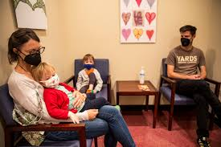
Scenario 3:
A student has been in the hospital and too sick for instruction.

Slide 19
Scenario 3 - What we did:
A student has been in the hospital and is too sick for instruction.
Initially, we marked as ‘AS’ as an excused absence
Then we speak with the parent about Home Instruction
The attendance will be marked as ASHE
Once the student can take instruction then we use HI

Slide 20
Scenario 4:
A student is not vaccinated with the required immunizations.

Slide 21
Scenario 4 – What we did:
A student is not vaccinated with the required immunizations.
The enrollment must be ended with code 430- Excluded pursuant to PHL 2164.
A new enrollment for the same school is needed with a start code 8300 – Compulsory age student, not attending.
Once they receive the vaccination they may re-enroll.
OR the parent may choose to Homeschool the student.

Slide 22
Scenario 5:
We have some students who go to alternate instruction in our school. The Instructional Team is working to get them back to their scheduled classes.

Slide 23
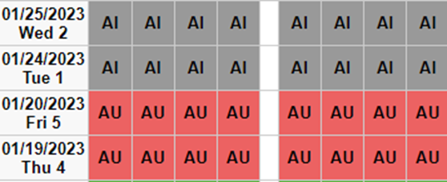
Scenario 5 – What we did:
We have some students who go to alternate instruction in our school. The Instructional Team is working to get them back to their scheduled classes.
The attendance is entered as ‘AI’ and is Absent from class but taking instruction.

Slide 24
Scenario 6:
We have a few students who have a modified schedule. They come in late and/or leave early.

Slide 25
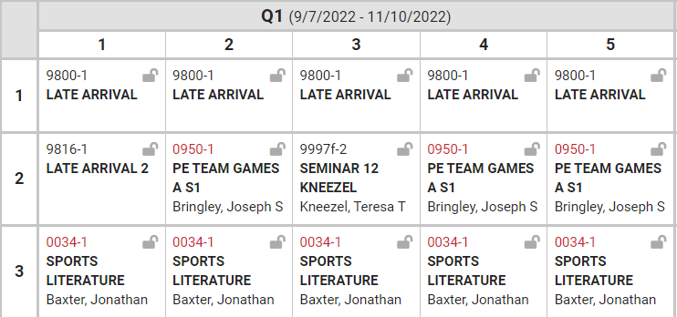
Scenario 6 – What we did:
We have a few students who have a modified schedule. They come in late and/or leave early.
The students are meeting the requirements for instruction with a period that does not have attendance.

Slide 26
Scenario 7:
A student is not able to come to school and the parent has sent them out of state to a medical facility.

Slide 27
Scenario 7 – What we did:
A student is not able to come to school and the parent has sent them out of state to a medical facility.
Enrollment is exited with code 430
New enrollment with start code 8300 – Compulsory age student, not attending, no documentation
Not enrolled in approved home schooling
Still of compulsory school age
Must be kept on the school’s attendance register
Return, the 8300 enrollment is ended with code 153 – Transferred to in district/out-of-district school. The next enrollment starts with 0011 – Enrollment in building or grade.
If they do not return, the next school year uses the 8300 code with a grade of UNK – Unknown.
Notes:
On register until they exceed compulsory school age, return to school or move out of the district

Slide 28
Other Scenarios?

Slide 29
Attendance letters:
November -7 days absence
March – 14 (7 new days)
June – 21 (7 new days)

Slide 30
Reports
The attendance clerks runs the report for the list of students who have missed the allotted # of days of school.
The Principal, Counselors, Nurse and Teacher(s) may review the list to qualify who should get a letter.

Slide 31
Notes:
https://www.youtube.com/watch?v=W153kbdwSKM&t=174s

Slide 32
Webinars:
Preparing for the ESSA restart for the 2022-23 SY
http://www.nysed.gov/accountability/school-and-district-accountability
https://www.p12.nysed.gov/irs/

Slide 33
Thank YOU!!

